Slide 1
Driving Transportation Projects Data Driven Project Evaluation
Bob Yeager
John Moore
Steve Ross
Eileen Vaughan

Slide 2
The Workgroup
Not Pictured:
Lindsay Carter, Brad Eldridge, Ron Rigney, Jarrod Stanley, Jon Wilcoxson, Thomas Witt

Slide 3
Tiered Prioritization
Statewide Mobility
Focus → Address Significant Congestion and Bottlenecks
Eligible Projects
Statewide type Projects (such as Interstates)
Selection based on 100% Data
Projects Programmed prior to Local Input Ranking
District Impact
Focus → Improve Connectivity within Regions
Eligible Projects
Projects Not Selected in Statewide Mobility Category
Regional Projects
Selection based on 70% Data & 30% Local Input
Funding based on population and Centerline w/i District (12)

Slide 4
Project Evaluation Criteria
Congestion
Benefit / Cost
Safety
Economic Development
Freight
Asset Management

Slide 5
Congestion

Slide 6
Benefit / Cost

Slide 7
Safety: Crash Characteristics Road Characteristics

Slide 8
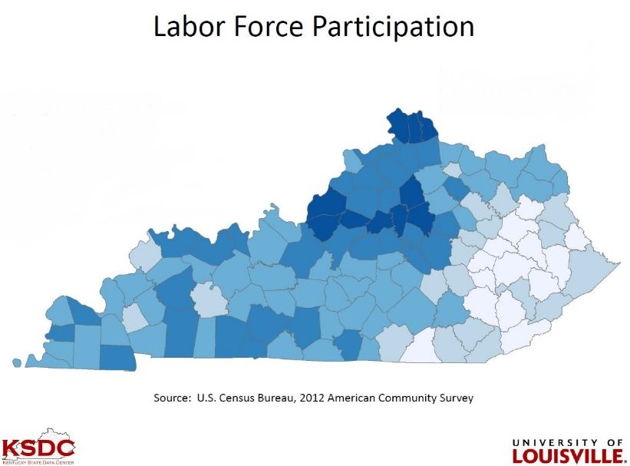
Economic Development: Economic Competitiveness Accessibility / Connectivity

Slide 9
Freight

Slide 10
Asset Management

Slide 11
Driving Transportation Projects Data Driven Project Evaluation

